Slide 1

UNIVERSITY INSTITUTE OF ENGINEERING
COMPUTER SCIENCE ENGINEERING
ARTIFICIAL INTELLIGENCE
(23CSH-621)
INTRODUCTION
DISCOVER . LEARN . EMPOWER

Slide 2
Genetic Algorithms
What is a Genetic Algorithm (GA)?
An adaptation procedure based on the mechanics of natural genetics and natural selection
Gas have 2 essential components
Survival of the fittest
Recombination
Representation
Chromosome = string
Gene = single bit or single subsequence in string, represents 1 attribute

Slide 3
Humans
DNA made up of 4 nucleic acids (4-bit code)
46 chromosomes in humans, each contain 3 billion DNA
4^{3 billion} combinations of bits
Can random search find humans?
Assume only 0.1% genome must be discovered, 3(10⁶) nucleotides
Assume very short generation, 1 generation/second
3.2(¹⁰¹⁰⁷) individuals per year, but 10^{1.8(107)} alternatives
10¹⁸¹⁰⁶ years to generate human randomly
Self reproduction, self repair, adaptability are the rule in natural systems, they hardly exist in the artificial world
Finding and adopting nature’s approach to computational design should unlock many doors in science and engineering

Slide 4
GAs Exhibit Search
Each attempt a GA makes towards a solution is called a chromosome
A sequence of information that can be interpreted as a possible solution
Typically, a chromosome is represented as sequence of binary digits
Each digit is a gene
A GA maintains a collection or population of chromosomes
Each chromosome in the population represents a different guess at the solution

Slide 5
The GA Procedure
Initialize a population (of solution guesses)
Do (once for each generation)
Evaluate each chromosome in the population using a fitness function
Apply GA operators to population to create a new population
Finish when solution is reached or number of generations has reached an allowable maximum.

Slide 6
Common Operators
Reproduction
Crossover
Mutation

Slide 7
Reproduction
Select individuals x according to their fitness values f(x)
Like beam search
Fittest individuals survive (and possibly mate) for next generation

Slide 8
Crossover
Select two parents
Select cross site
Cut and slice pieces of one parent to those of the other
1 1 1 1 1
0 0 0 0 0
1 1 0 0 0
0 0 1 1 1

Slide 9
Mutation
With small probability, randomly alter 1 bit
Minor operator
An insurance policy against lost bits
Pushes out of local minima
Population:
1 1 0 0 0 0
1 0 1 0 0 0
1 0 0 1 0 0
0 1 0 0 0 0
Goal: 0 1 1 1 1 1
Mutation needed to find the goal

Slide 10
GAs for Optimization
Traveling salesman problem
Eaters
Hierarchical GAs for game playing

Slide 11

An optimization method.
Population-based,
bio-inspired
first introduced as an evolutionary stochastic optimization technique for nonlinear functions by Kennedy and Eberhart in 1995 .

Slide 12
It was originally inspired
in the way crowds of individuals move towards predefined objectives,
but it is better viewed using a social metaphor.

Slide 13
Individuals in the population try to move towards
the fittest position known
to them and
to their informants, that is, the set of individuals that are their social circle.
The objective is to maximize or minimize a fitness function.

Slide 14
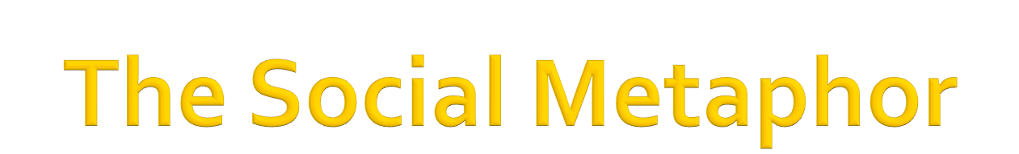
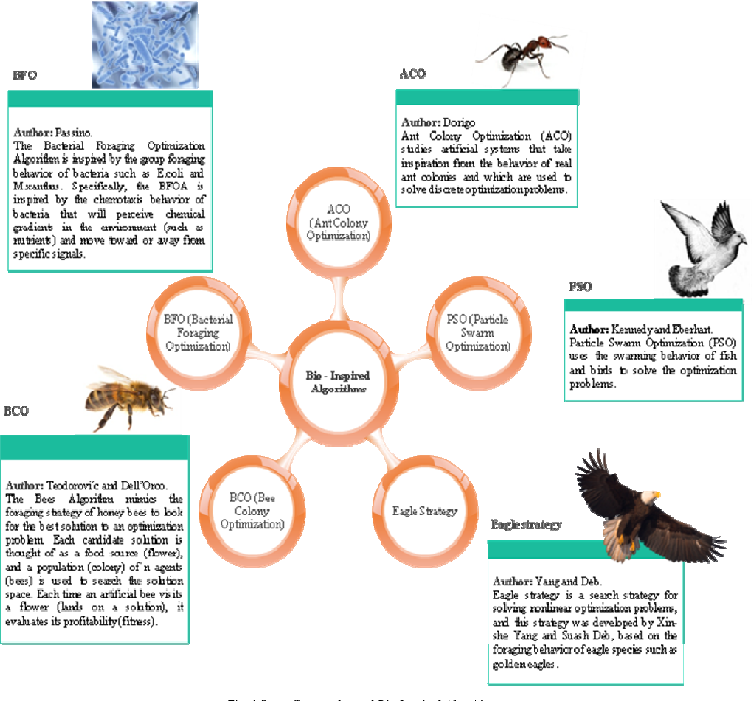
The PSO algorithm is a
biologically-inspired algorithm
motivated by a social analogy.
Sometimes it is related to the
Evolutionary Computation (EC) techniques,
basically with Genetic Algorithms (GA) and
Evolutionary Strategies (ES),
but there are significant differences with those techniques.

Slide 15
The PSO algorithm is
population-based:
a set of potential solutions
evolves
to approach a convenient solution (or set of solutions) for a problem.

Slide 16
Being an optimization method, the aim is finding the global optimum of a real-valued function (fitness function) defined in a given space (search space).

Slide 17
The social metaphor that led to this algorithm can be summarized as follows:
the individuals that are part of a society
hold an opinion that is part of a "belief space" (the search space)
shared by every possible individual.

Slide 18
Individuals may modify this "opinion state" based on three factors:
The knowledge of the environment (its fitness value)
The individual's previous history of states (its memory)
The previous history of states of the individual's neighborhood

Slide 19
An individual's neighborhood may be defined in several ways, configuring somehow the "social network" of the individual.
Several neighborhood topologies exist
(full, ring, star, etc.) depending on
whether an individual interacts with all, some, or only one of the rest of the population.

Slide 20
Following certain rules of interaction,
the individuals in the population adapt their scheme of belief to the ones that are more successful among their social network.
Over the time, a culture arises, in which the individuals hold opinions that are closely related.

Slide 21

Each individual is called a "particle", and
Each individual is subject to a movement in a multidimensional space that represents the belief space.
Particles have memory, thus retaining part of their previous state.
There is no restriction for particles to share the same point in belief space, but in any case their individuality is preserved.
Each particle's movement is the composition of an initial random velocity and two randomly weighted influences: individuality, the tendency to return to the particle's best
previous position, and sociality, the tendency to move
towards the neighborhood's

Slide 22
References
Book:
Demuth, Howard B., et al. Neural network design. Martin Hagan, 2014.
Sivanandam, S.N., Deepa, S. N, Introduction to Genetic Algorithms
Websites:
https://www.slideshare.net/databricks/introduction-to-neural-networks-122033415
https://www.slideshare.net/genetic-algorithm-ppt
https://www.slideshare.net/khashe62/practical-swarm-optimization-pso#:~:text=Particle%20Swarm%20Optimization%20How%20it,criterion%20after%20each%20time%20step.

Slide 23
THANK YOU

